Slide 1
Algorithm and Data Structures
Week 11
Endang Wahyu Pamungkas, Ph.D.

Slide 2
Trees
A tree is a data structure that stores information elements in a hierarchical manner. This tree structure consists of nodes and edges.
Between nodes have a parent relationship, child, ancestor, descendant, and so on. In principle, the data in the tree is stored in nodes, a pair of nodes is connected by an edge, and a node can only have a maximum of one parent.
Edges represent relationships between nodes connected by arrows/lines to form a hierarchical structure resembling an inverted tree with branches, leaves, and roots.

Slide 3
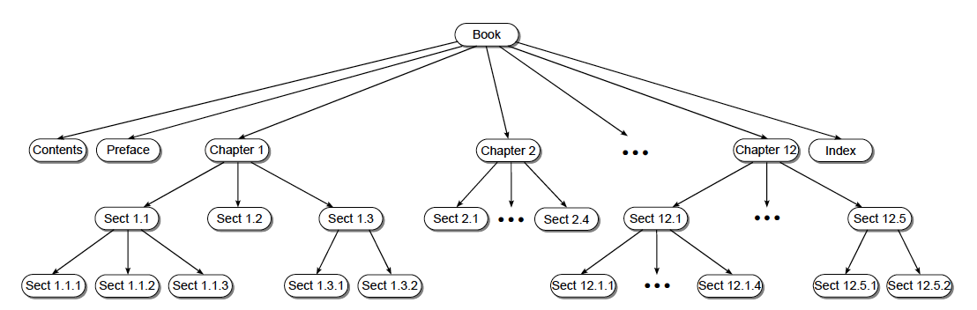
Trees

Slide 4
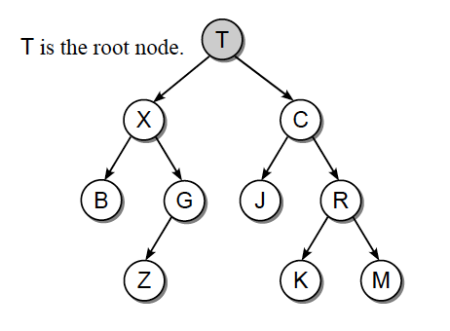
Root
A tree consists of nodes. Data is stored in a node. Each node can have a connection or edge to another node. Each tree has a special node, namely the root node (root node). The root node is the top most node. The root node has no parent or no incoming edge. In the following figure, the root of the tree is T.

Slide 5
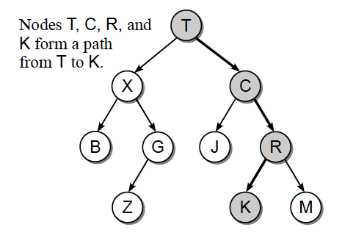
Paths
Once at the root node, other nodes are accessed through the edges. Starting at the root, walk in the direction of the arrow until the desired node is reached. The vertices that are visited while traveling the edges, from the starting node to the destination node, form a path.

Slide 6
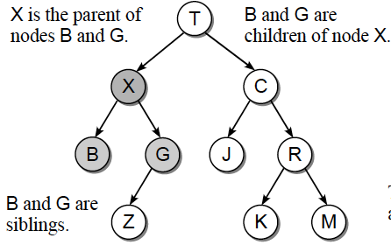
Parents
Each node, except the root node, has one parent node, which is identified from the incoming edge. A vertex can only have one parent (that is, only one incoming edge). This creates a unique path from the root node to any other node in the tree.

Slide 7
Childs
Each node in the tree can have multiple children, which creates a parent-child hierarchy. The child of a node is identified from the edge that points outward. All nodes that have the same parent are called sibling, but there is no direct access between siblings. So that we cannot directly access node C from node X and vice versa.

Slide 8
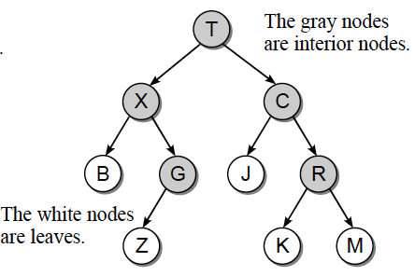
Interior Nodes and Leaf Nodes
A node that has at least one child is called an interior node or inner node. This node is not located at the end of a tree. Nodes that have no children are called leaf nodes. This node is located at the end of a tree.

Slide 9
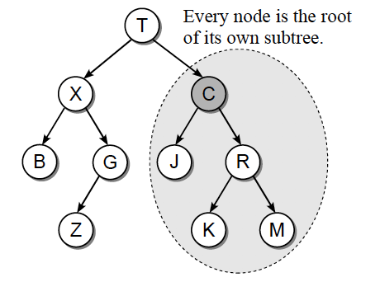
Subtree
Each node can be the root of its own subtree, which consists of the nodes and edges of the larger main tree.

Slide 10
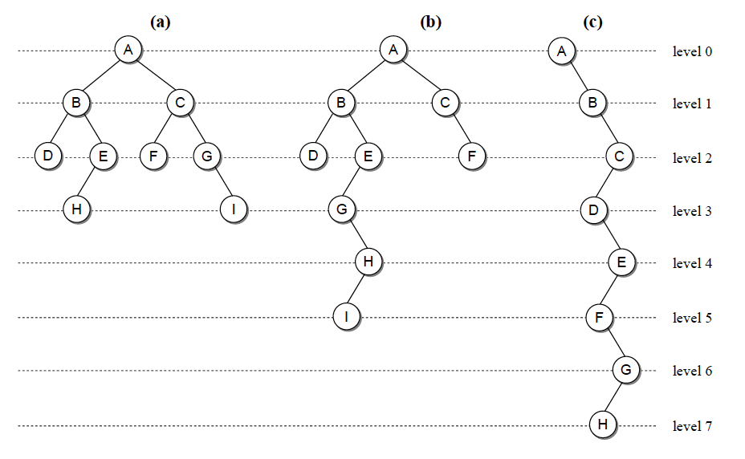
Tree Sizes
The nodes in a tree are organized into levels with the root node at level 0, its children at node 1, its children at node 2, and so on. In family tree terms, one level is one generation. The tree in figure (a) below, for example, has two nodes at level one (B and C), four nodes at level two (D, E, F, and G), and two nodes at level three (H and C). I). The root node always occupies the zero level.

Slide 11
Tree Sizes
The depth of a node is the distance of that node from the root node, where distance is the number of levels separating the two. The depth of a node is related to the level at which it is located.
The height of a tree is the number of levels in the tree. For example, in the picture above, tree (a) has a height of 4, tree (b) has a height of 8, tree (c) has a height of 8.
The width of a tree is the number of nodes at the level that has the most nodes. In the three binary trees in the figure above, tree (a) has a width of 4, tree (b) has a width of 3, and tree (c) has a width of 1.
The size of a tree is the number of nodes in the tree. In the tree above, the size of the tree is 8. An empty tree has a height of 0, a width of 0, and a size of 0.

Slide 12
Binary Tree
A binary tree is a tree in which each node can have at most two children. One child node is named the left child and the other is named the right child.

Slide 13
Binary Tree Construction
Binary trees are generally implemented with a dynamic structure similar to a linked list implementation.
Tree structures are usually illustrated as abstract structures using vertices represented by circles or squares and edges represented by lines or arrows.
To implement a binary tree, at each node we must store the data contents of that node as well as the links to its two children.
class Simpul(object):
def __init__(self, data):
self.data = data
self.kiri = None
self.kanan = None

Slide 14
Binary Tree Construction
A = Simpul(’Ambarawa’)
B = Simpul(’Bantul’)
C = Simpul(’Cilacap’)
D = Simpul(’Denpasar’)
E = Simpul(’Enrekang’)
F = Simpul(’Flores’)
G = Simpul(’Garut’)
H = Simpul(’Halmahera’)
I = Simpul(’Indramayu’)
J = Simpul(’Jakarta’)
A.kiri = B
A.kanan = C
B.kiri = D
B.kanan = E
C.kiri = F
C.kanan = G
E.kiri = H
G.kanan = I

Slide 15
Tree Traversal
In binary tree, we can do Tree Traversal. The Tree Travelsal technique is a way of visiting the nodes in the binary tree. There are 3 ways of tree traversals, namely: in-order, pre-order, and post-order. Here's how to use it:
In-order : left, root, right
Pre-order: root, left, right
Post-order: left, right, root
https://visualgo.net/en/bst?slide=3-8

Slide 16
In Order
First, visit all the nodes in the left subtree
Then the root node
Visit all the nodes in the right subtree
def inorder(root):
if root:
# Traverse left
inorder(root.left)
# Traverse root
print(str(root.val) + "->", end='')
# Traverse right
inorder(root.right)

Slide 17
Pre Order
Visit root node
Visit all the nodes in the left subtree
Visit all the nodes in the right subtree
def preorder(root):
if root:
# Traverse root
print(str(root.val) + "->", end='')
# Traverse left
preorder(root.left)
# Traverse right
preorder(root.right)

Slide 18
Post Order
Visit all the nodes in the left subtree
Visit all the nodes in the right subtree
Visit the root node
def postorder(root):
if root:
# Traverse left
postorder(root.left)
# Traverse right
postorder(root.right)
# Traverse root
print(str(root.val) + "->", end='')

Slide 19
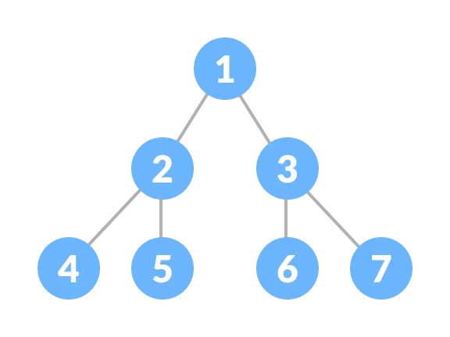
Exercise
Build a perfect binary tree structure as shown on the below image.
Traverse the binary tree structure with preorder, inorder, and postorder. Print the visited node to show the differences between them.

